Slide 1
Task 1: Identifying the Top Branch by Sales Growth Rate WITH monthly_sales AS ( SELECT Branch, MONTH(STR_TO_DATE(Date, '%d-%m-%Y')) AS month, YEAR(STR_TO_DATE(Date, '%d-%m-%Y')) AS year, SUM(Total) AS monthly_sales FROM walmart.walmartsales GROUP BY Branch, YEAR(STR_TO_DATE(Date, '%d-%m-%Y')), MONTH(STR_TO_DATE(Date, '%d-%m-%Y’))) SELECT Branch, month, monthly_sales, ROUND( (monthly_sales - LAG(monthly_sales) OVER (PARTITION BY Branch ORDER BY year, month)) / LAG(monthly_sales) OVER (PARTITION BY Branch ORDER BY year, month) * 100, 2 ) AS growth_rate FROM monthly_sales ORDER BY growth_rate DESC LIMIT 1;
# Branch | month | monthly_sales | growth_rate
A | 3 | 37659.12 | 26.12

Slide 2
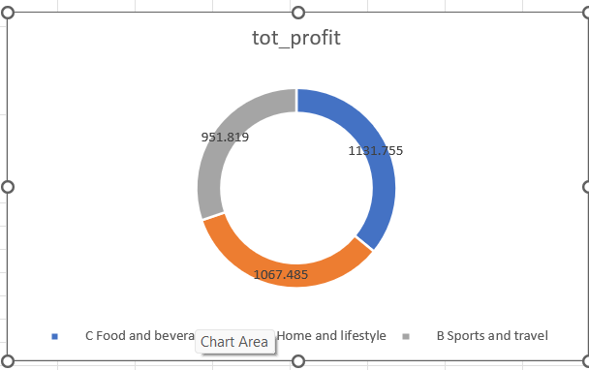
Task 2: Finding the Most Profitable Product Line for Each Branch WITH ProfitSummary AS ( SELECT branch, productline, SUM(total - cogs) AS tot_profit FROM walmart.walmartsales GROUP BY branch, productline)SELECT branch, productline, tot_profit FROM ProfitSummary WHERE (branch, tot_profit) IN ( SELECT branch, MAX(tot_profit) FROM ProfitSummary GROUP BY branch)ORDER BY branch;
# branch | productline | tot_profit
C | Food and beverages | 1131.755
A | Home and lifestyle | 1067.485
B | Sports and travel | 951.819

Slide 3
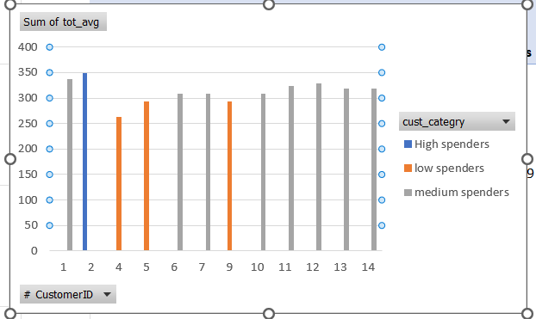
task 3 Analyzing Customer Segmentation Based on Spending use Walmart; with cust_spending as (select CustomerID,AVG(Total) as tot_avg FROM walmart.walmartsales group by CustomerID),cust_tier as (select CustomerID,tot_avg, case when tot_avg >=(select(max(tot_avg)*.85) from cust_spending) then 'High spenders’ when tot_avg>=(select max(tot_avg)*.75 from cust_spending )and tot_avg<(select max(tot_avg)*.85 from cust_spending) then 'medium spenders’ else 'low spenders’ end as cust_categry from cust_spending) select* from cust_tier order by cust_categry desc;
# CustomerID | tot_avg | cust_categry
11 | 324.2246 | medium spenders
13 | 319.1464 | medium spenders
1 | 337.829 | medium spenders
12 | 329.1007 | medium spenders
14 | 318.9303 | medium spenders
10 | 309.3124 | medium spenders
6 | 308.865 | medium spenders
7 | 307.8819 | medium spenders
9 | 293.4567 | low spenders
5 | 293.0155 | low spenders
4 | 263.5331 | low spenders
2 | 349.1385 | High spenders

Slide 4
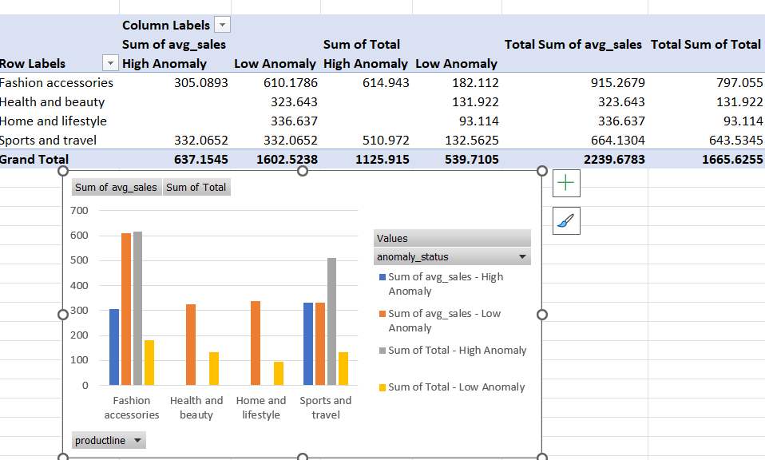
--TASK 4 Detecting Anomalies in Sales Transactions WITH sales_with_avg AS ( SELECT `Invoice ID`, productline, Total, AVG(Total) OVER (PARTITION BY productline) AS avg_sales FROM walmartsales) SELECT `Invoice ID`, productline, Total, avg_sales, CASE WHEN Total > avg_sales * 1.5 THEN 'High Anomaly’ WHEN Total < avg_sales * 0.5 THEN 'Low Anomaly’ END AS anomaly_status FROM sales_with_avg WHERE Total > avg_sales * 1.5 OR Total < avg_sales * 0.5;
# Invoice ID | productline | Total | avg_sales | anomaly_status
101-81-4070 | Health and beauty | 131.922 | 323.643 | Low Anomaly
102-06-2002 | Sports and travel | 132.5625 | 332.0652 | Low Anomaly
105-10-6182 | Fashion accessories | 45.108 | 305.0893 | Low Anomaly
105-31-1824 | Sports and travel | 510.972 | 332.0652 | High Anomaly
106-35-6779 | Home and lifestyle | 93.114 | 336.637 | Low Anomaly
109-28-2512 | Fashion accessories | 614.943 | 305.0893 | High Anomaly
110-48-7033 | Fashion accessories | 137.004 | 305.0893 | Low Anomaly

Slide 5
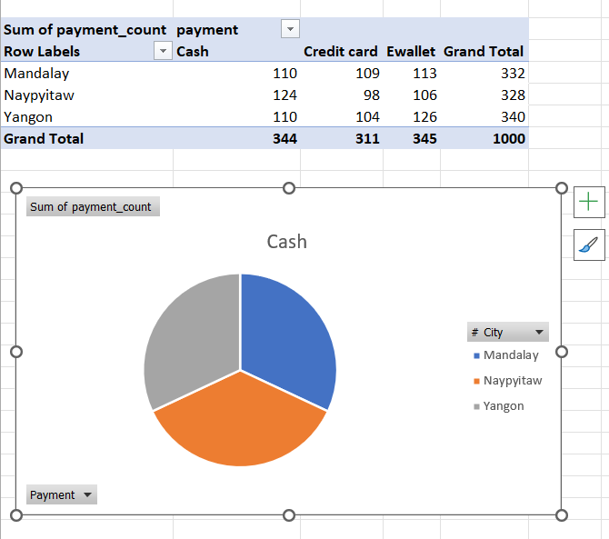
Task 5: Most Popular Payment Method by City SELECT City, Payment, COUNT(Payment) AS payment_count FROM walmart.walmartsales GROUP BY City, Payment ORDER BY City, payment_count DESC;
# City | Payment | payment_count
Mandalay | Ewallet | 113
Mandalay | Cash | 110
Mandalay | Credit card | 109
Naypyitaw | Cash | 124
Naypyitaw | Ewallet | 106
Naypyitaw | Credit card | 98
Yangon | Ewallet | 126
Yangon | Cash | 110
Yangon | Credit card | 104

Slide 6
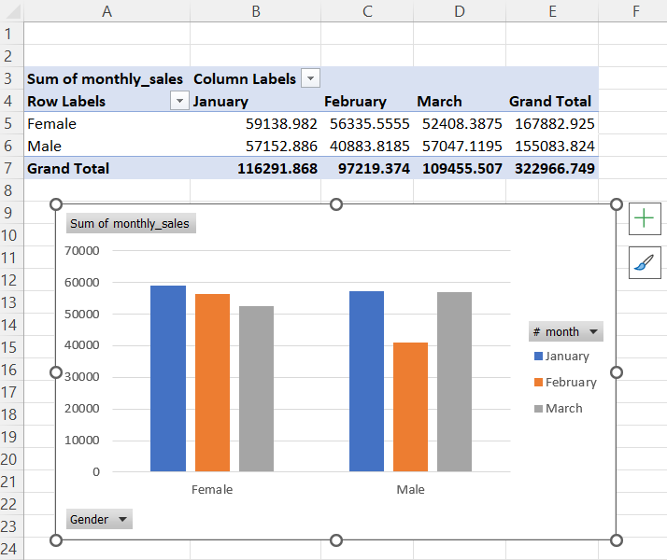
TASK 6 Monthly Sales Distribution by Gender SELECT MONTHNAME(STR_TO_DATE(Date, '%d-%m-%Y')) AS month, Gender, SUM(Total) AS monthly_sales FROM walmart.walmartsales GROUP BY month, Gender ORDER BY month;
# month | Gender | monthly_sales
February | Female | 56335.56
February | Male | 40883.82
January | Female | 59138.98
January | Male | 57152.89
March | Female | 52408.39
March | Male | 57047.12

Slide 7
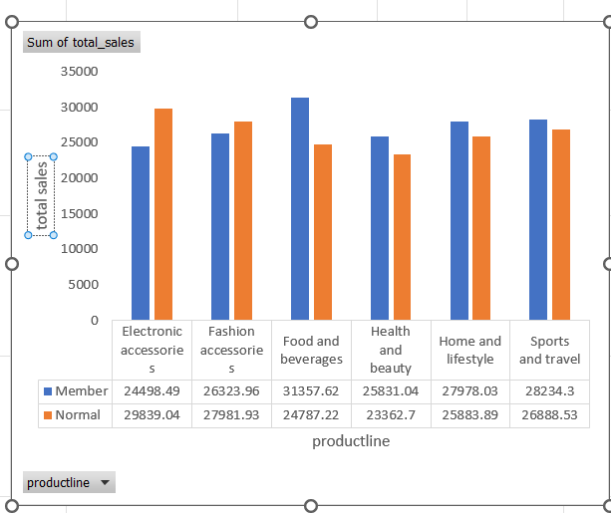
-- Task 7: Best Product Line by Customer Type SELECT Customertype, productline, SUM(Total) AS total_sales FROM WALMART.WALMARTSALES GROUP BY Customertype, productline ORDER BY Customertype, total_sales DESC;
# Customertype | productline | total_sales
Member | Food and beverages | 31357.62
Member | Sports and travel | 28234.3
Member | Home and lifestyle | 27978.03
Member | Fashion accessories | 26323.96
Member | Health and beauty | 25831.04
Member | Electronic accessories | 24498.49
Normal | Electronic accessories | 29839.04
Normal | Fashion accessories | 27981.93
Normal | Sports and travel | 26888.53
Normal | Home and lifestyle | 25883.89
Normal | Food and beverages | 24787.22
Normal | Health and beauty | 23362.7

Slide 8
Task 8: Identifying Repeat Customers SELECT CustomerID, COUNT(`Invoice ID`) AS purchase_count, MIN(Date) AS first_purchase_date, MAX(Date) AS last_purchase_date FROM walmart.walmartsales GROUP BY CustomerID HAVING DATEDIFF(MAX(Date), MIN(Date)) <= 30 AND COUNT(`Invoice ID`) > 1;

Slide 9
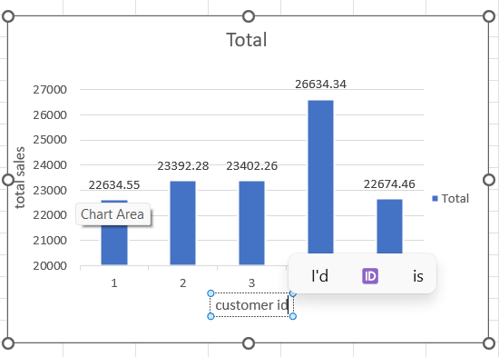
Task 9: Finding Top 5 Customers by Sales Volume SELECT CustomerID, SUM(Total) AS total_sales_volume FROM walmart.walmartsales GROUP BY CustomerID ORDER BY total_sales_volume DESC LIMIT 5;
# CustomerID | total_sales_volume
8 | 26634.34
3 | 23402.26
2 | 23392.28
15 | 22674.46
1 | 22634.55

Slide 10
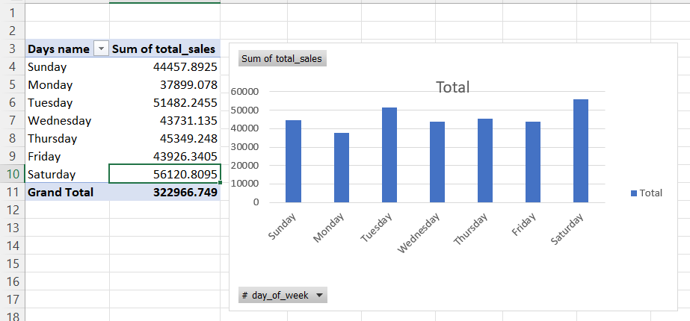
TASK 10 Analyzing Sales Trends by Day of the Week SELECT DAYNAME(STR_TO_DATE(Date, '%d-%m-%Y')) AS day_of_week, SUM(Total) AS total_sales FROM walmart.walmartsales GROUP BY day_of_week
# day_of_week | total_sales
Saturday | 56120.81
Friday | 43926.34
Sunday | 44457.89
Monday | 37899.08
Thursday | 45349.25
Wednesday | 43731.14
Tuesday | 51482.25

Slide 11
Anshika SQLProject video 🔗 https://drive.google.com/file/d/1YmB4gaCKKTchkfZSrllpmdU_HCZHkofq/view?usp=drivesdk

